Slide 1

SHARAN ERRAGUNTLA, TARUN MERUVA, MAHIM NALLURI, SAYYANT RATH & NIRANJANA SAVE

Slide 2
AGENDA
PROBLEM STATEMENT
IMPACT
PRODUCT
FUTURE PLANS

Slide 3
1.
PROBLEM STATEMENT
What issue does Zeus solve?

Slide 4
1 million terajoules
Global daily energy consumption
Source: BBC

Slide 5
How can we monitor and address energy usage to reduce overconsumption and promote environmental sustainability?
Notes:
Energy consumption is on the rise and impacts society economically, environmentally, and socially.

Slide 6
2.
IMPACT
About Zeus

Slide 7
What is Zeus?
Zeus is an AI based online service that helps business and commercial buildings determine their energy usage and create plans to help cut energy consumption, and consequently, energy costs

Slide 8
Zeus’ Positive Impact
Consumption Insights
- Receive daily insights on energy consumption
- Filter data by appliance to learn where energy is consumed the most
Savings Ideas
- Use Zeus’ virtual assistant to find different ways to save on your energy costs
- Savings recommendations based on your energy provider, building type, and location
Seasonal Planning
- Zeus will compare your energy consumption to the different plans offered by your energy provider to choose the best plan for your usage rates

Slide 9
3.
PRODUCT
How does Zeus work?

Slide 10
Technologies
Front End
React
Hosted on AWS
Back End
Excel
Flask
Python
Pandas
Matplotlib
Turicreate

Slide 11
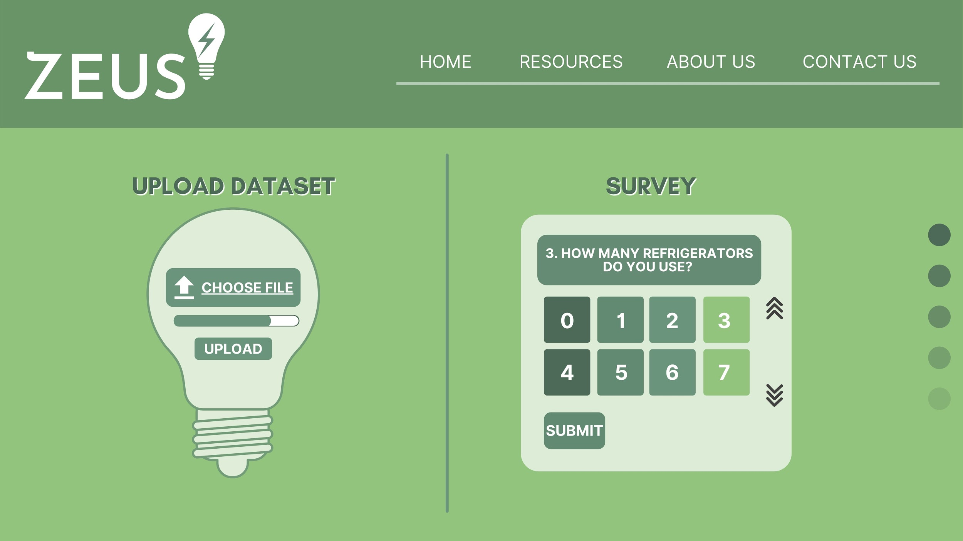
HOMEPAGE
Features two options to gather data
Uploading dataset
Survey
Compiles dashboard based on results

Slide 12
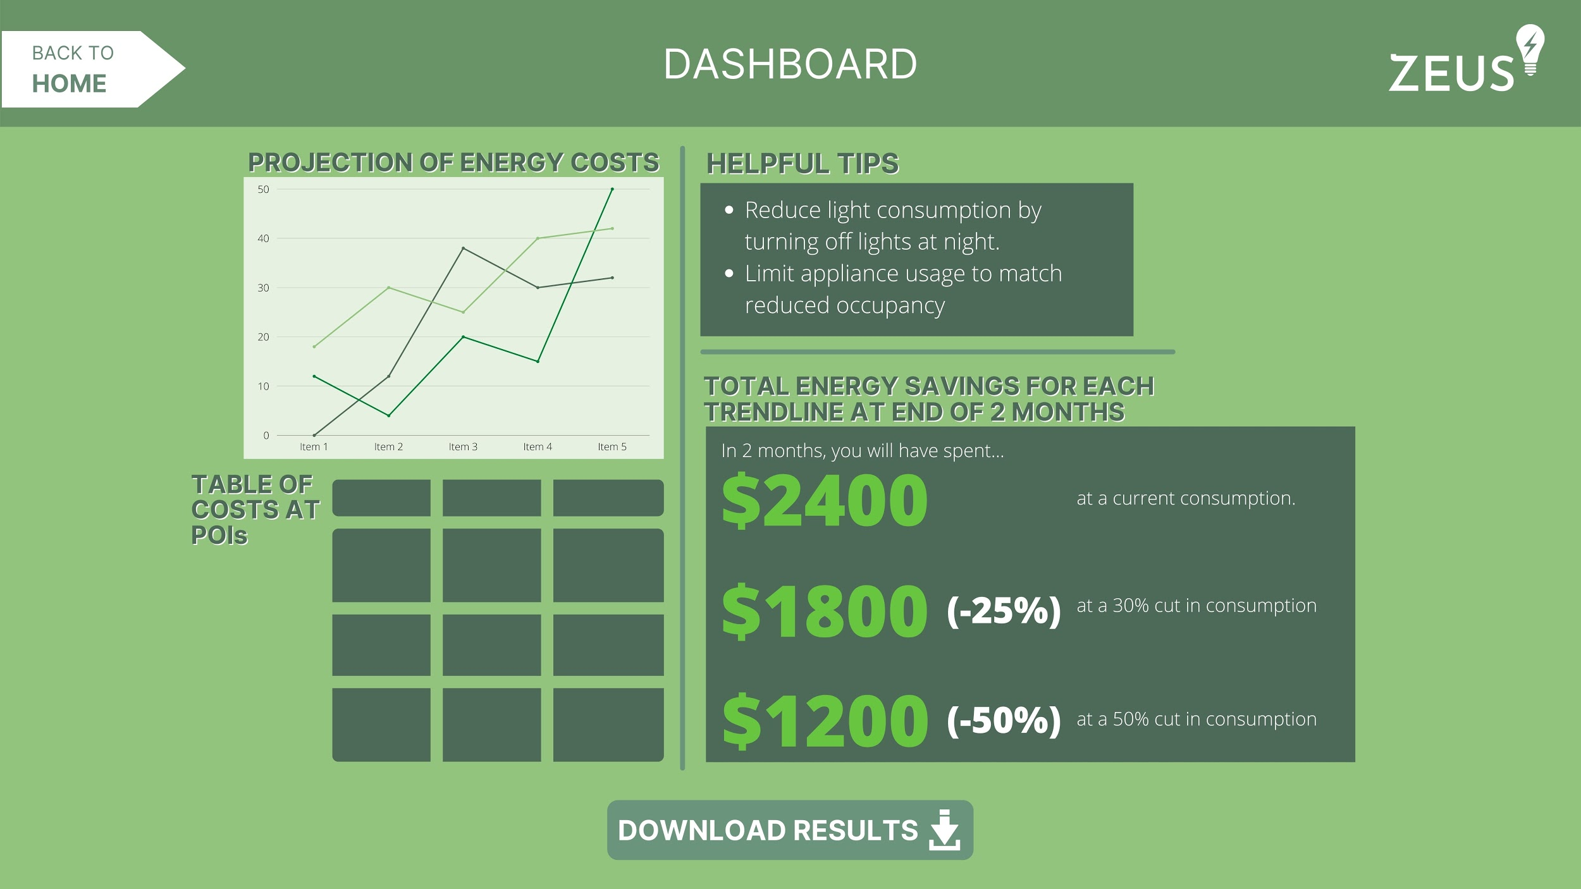
DASHBOARD
Compiled recommendation plans which include:
Future usage forecasts
Alternatives
Cost savings
Based on:
Usage data

Slide 13
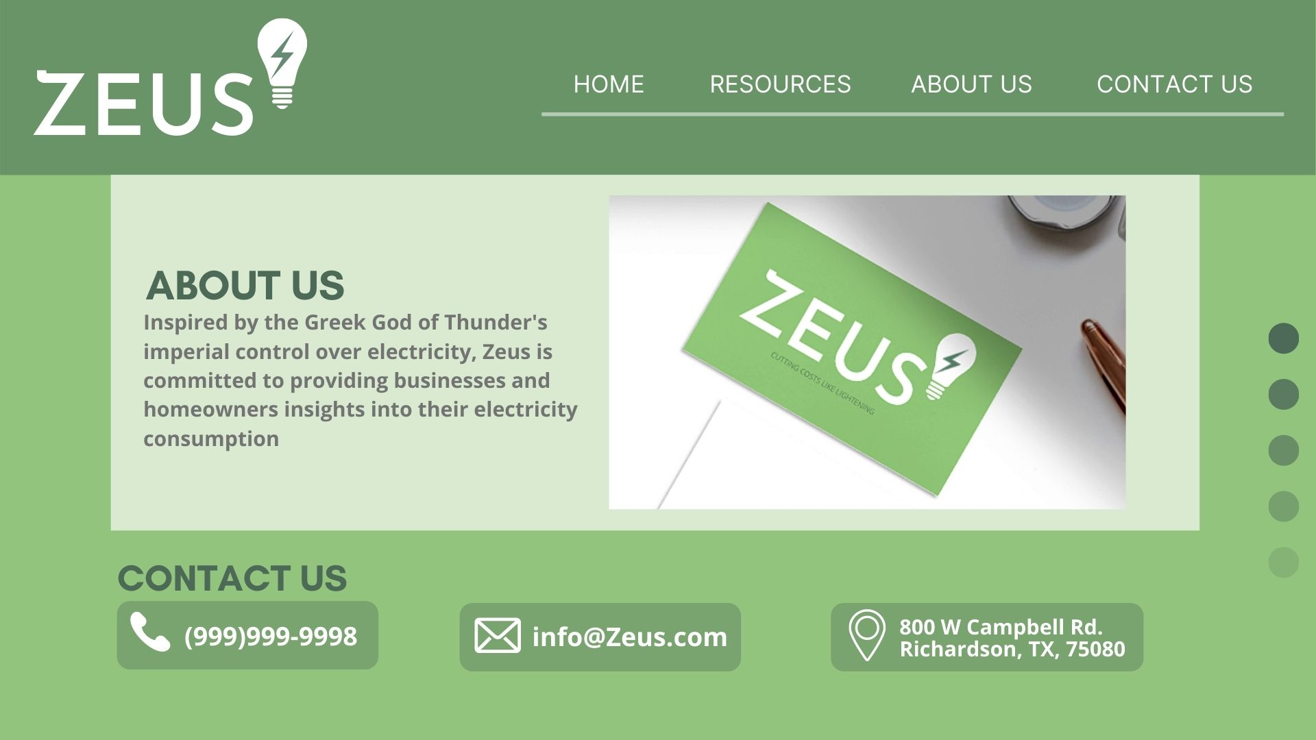
ABOUT US
A description of services
Contact information

Slide 14
4.
FUTURE PLANS
Looking ahead

Slide 15


VIRTUAL ASSISTANT
A possible feature to provide 24 hour support online
HOW CAN I HELP YOU TODAY?

Slide 16
SCALABILITY
Businesses
Residential Homes
National Global

Slide 17
THANK YOU!

